Slide 1

Developing Research Data Management Services
Joy Davidson, Jonathan Rans, Angus Whyte
Digital Curation Centre
This work is licensed under the Creative Commons Attribution 2.5 UK: Scotland License.
Notes:
DCC is primarily supported by Jisc, the European Commission projects and consultancy.
For the past decade, we’ve been working to help HEIs to build capacity for digital curation and RDM. We’ve worked extensively with UK HEIs to help them define and implement RDM services and we’ll draw from these experiences to help you to scope and implement RDM services at your own institutions.
Good range of participants here today – from EU, Korea, South Africa – so it is clear that establishing and delivering RDM services is a global concern.

Slide 2
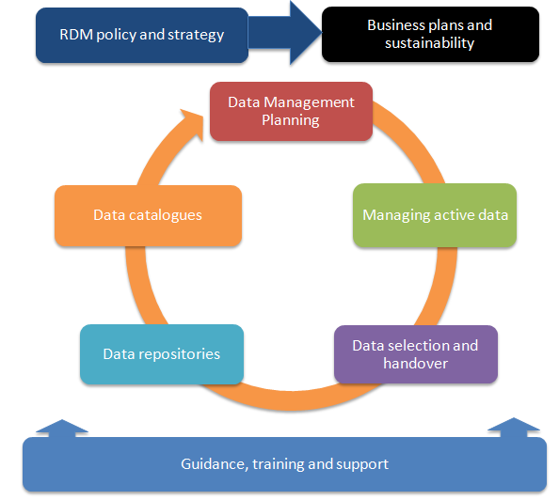
About this course
Scoping, refining, delivering and sustaining RDM services
Practical exercise to explore a particular RDM service in detail
http://www.dcc.ac.uk/resources/developing-rdm-services
http://www.dcc.ac.uk/resources/how-guides
Notes:
Over the course of the day, we’ll have a number of brief presentations that will consider scoping, refining, delivering and sustaining research data management services.
There will be a number of short exercises throughout the day where you will work in groups to consider a particular RDM service in more detail. Many of you have indicated that you are just starting out with scoping RDM services while others are further down the line and are currently rolling out pilot services or are delivering more established RDM services. We’d encourage those with more experience to share lessons learned with colleagues who as just starting out as you work through the exercises.
Through the short exercises, each group will develop a business canvas model for a particular RDM service. We’ve asked each group to consider a particular service aspect of RDM rather than RDM as a whole. In most cases, RDM services are not a single entity but instead are spread across the institution and involve many different operational units. In this respect, it is very difficult to come up with an accurate picture of the RDM as a whole without looking at the individual RDM services to see how costs are incurred and covered across the portfolio of services.
We’ve got five groups – two will looking at training, guidance and support for RDM, one looking at data management planning; one looking at managing active data; and one looking at RDM policy and strategy.
DCC offers some good case studies and how to guides at the link provided. All of the slides will be made available so no need to worry about capturing these urls now.

Slide 3
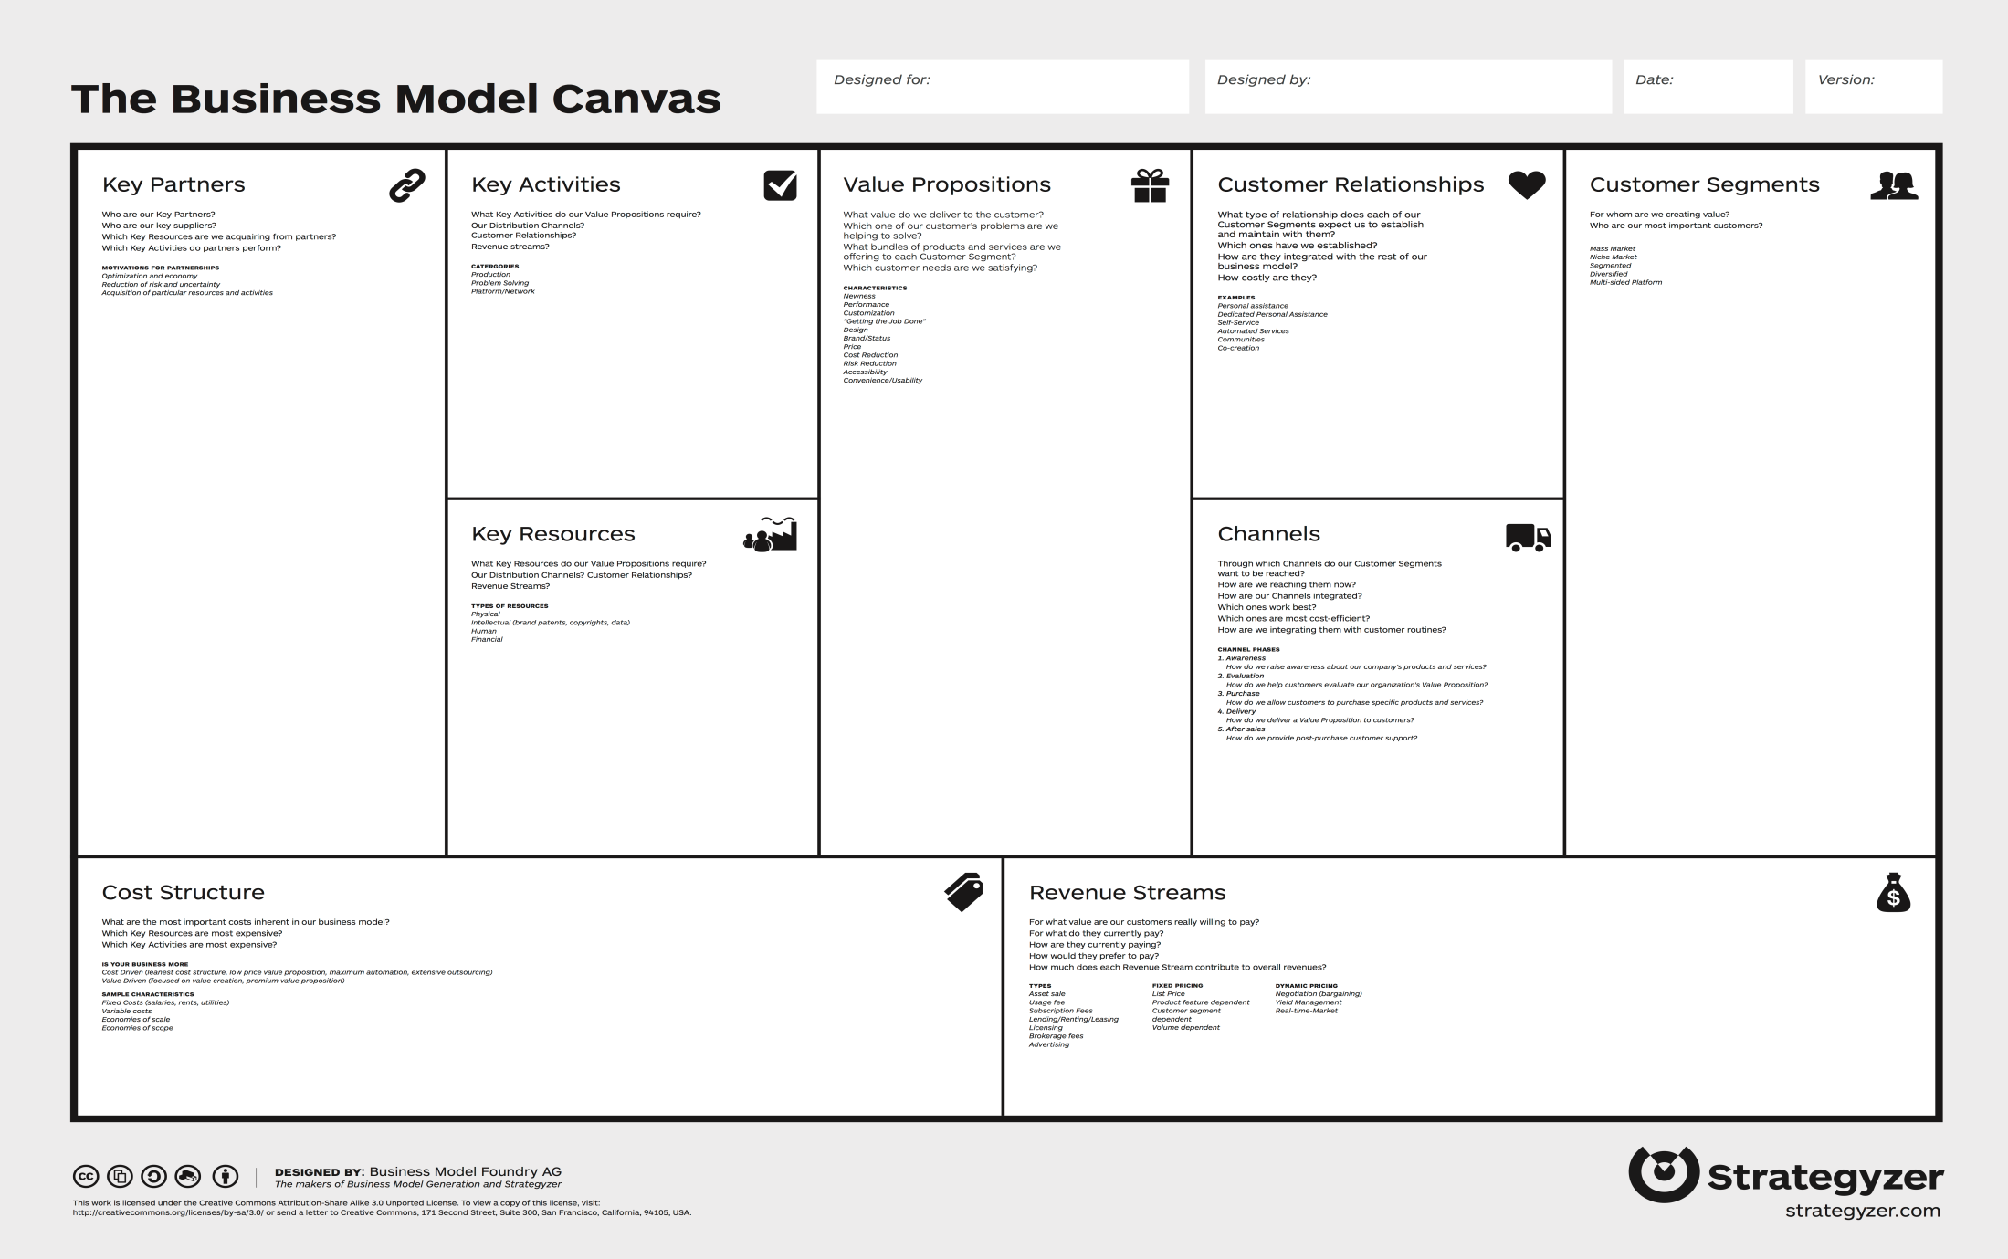
How does the BMC work?
http://www.businessmodelgeneration.com/canvas/bmc
Notes:
The BMC allows you to look at a given service from customer, activities, and financial perspectives.
The Business Model Canvas should ‘be printed out on a large surface so groups of people can jointly start sketching and discussing business model elements with post-it note notes or board markers. It is a hands-on tool that fosters understanding, discussion, creativity, and analysis’. https://en.wikipedia.org/wiki/Business_Model_Canvas
The BMC is meant to be completed collaboratively to allow different view points to be captured. It is recommended that you use post its to jot down ideas for each section so that these can be moved around as needed. You’ll be giving this a go as we move through the day.
In a nutshell, the BMC is completed by:
Considering your customers – who is the service for?
Thinking about the value proposition – what value will the service deliver to your customers?
Assessing how you build a relationship with your customers (i.e., how do you communicate your services and values to your customers).
Considering what channels are provided to allow your customers to communicate their needs and satisfaction with the service to you.
Identifying the key activities involved in delivering the service.
Considering the resources needed to deliver the service (human, financial, technical).
Identifying any partnerships that might be needed to deliver the service (other operational units, third party service providers, research project partners).
Identifying the range of costs incurred through delivering a given service.
Understanding how the costs incurred are recovered through revenue streams. Are services charged or are they covered through indirect funding?
Important to be clear that completing a BMC will not give you a business plan but it will provide you with the building blocks to develop a more realistic and feasible business plan
We’ve included some guidance in your packs to help you to use the model today and when you return home.

Slide 4

Thanks for listening!
DCC guidance, tools and case studies:
www.dcc.ac.uk/resources
Follow us on twitter:
@digitalcuration and #ukdcc

